Slide 1



Slide 2

Agenda
About HTML, CSS
CSS naming methodology
Responsive web design
SCSS introduction
Tools and Others
Assignment

Slide 3
HTML5

Slide 4
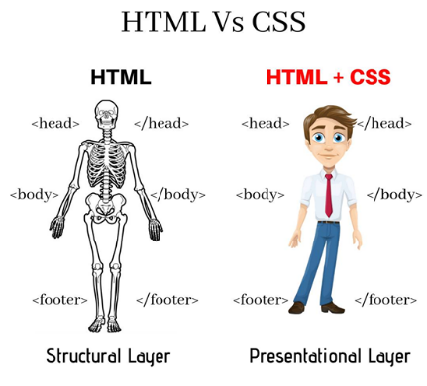
How do you understand about HTML & CSS?
HTML represents the content structure
For example: headings, paragraphs, or images
CSS represents the appearance of that content
For example: fonts or colors
(Image source from Codexier)
Notes:
Discussion question – asking trainees to see what they understand about HTML & CSS.

Slide 5
Common HTML tags
Basic HTML:
Common layout elements: <div>, <span,> <table>, <thead>, <th>, <tbody>, <tr>, <td>, <iframe>
Common form elements: <form>, <label>, <input>, <select>, <option>, <textarea>, <button>, <fieldset>, <legend>
Common article elements: <h1> -> <h6>, <p>, <img>, <a>, <br>, <ul>, <li>
Use standard HTML tags and attributes in order to support web accessibility, SEO. Should avoid custom tags, custom attributes.

Slide 6
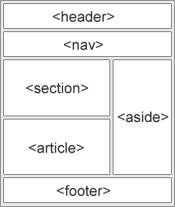
Semantic layout elements
<header> Defines a header for a document or a section
<nav> Defines a set of navigation links
<section> Defines a section in a document
<article> Defines an independent, self-contained content
<aside> Defines content aside from the content (like a sidebar)
<footer> Defines a footer for a document or a section
<details> Defines additional details that the user can open and close on demand
<summary> Defines a heading for the <details> element

Slide 7
References
HTML document: https://www.w3schools.com/html/default.asp
https://seekbrevity.com/semantic-markup-important-web-design/
Best practice how to write beautiful HTML
https://css-tricks.com/examples/CleanCode/Beautiful-HTML.png

Slide 8
CSS/SCSS

Slide 9
Common CSS rules
Selectors: #id, .class, :hover, etc.
Functions: calc(), rgb(), rgba()
Flexbox
Alignment item in container
Position
Display
Transition
Tranform
z-index
Overflow

Slide 10
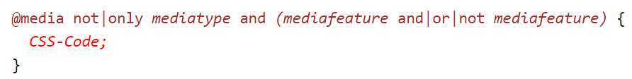
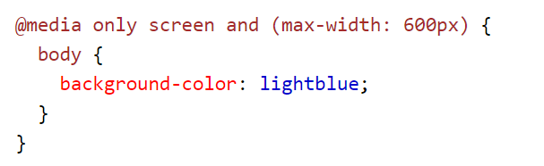
Media
Media syntax
Example

Slide 11
Media types
Value | Description
all | Default. Used for all media type devices
print | Used for printers
screen | Used for computer screens, tablets, smart-phones etc.
speech | Used for screenreaders that "reads" the page out loud

Slide 12
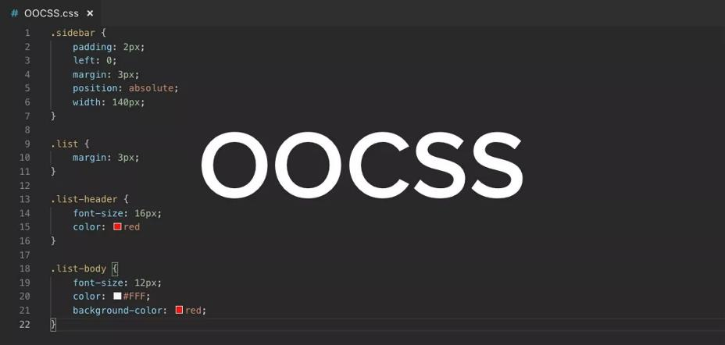
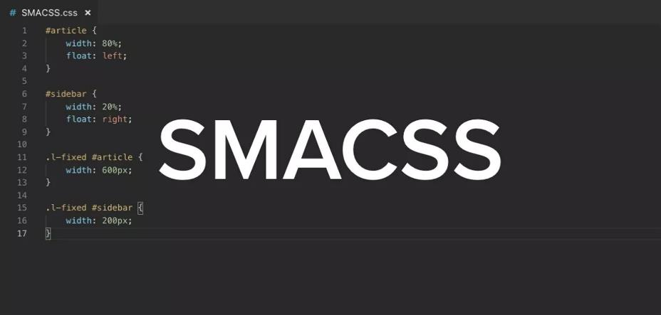
Naming methodology

Slide 13
Responsive web design
Grid system
Screen size: xs, sm, md, lg, xl
Bootstrap framework

Slide 14
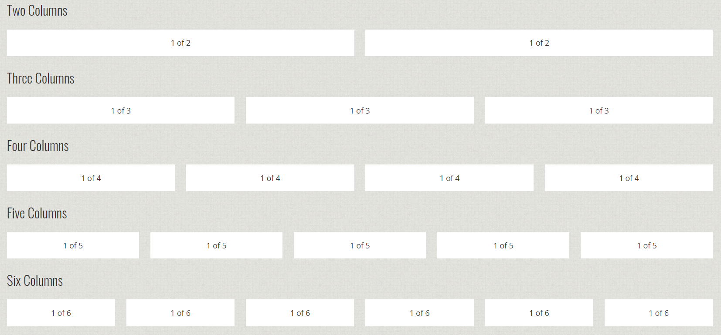
Grid system

Slide 15
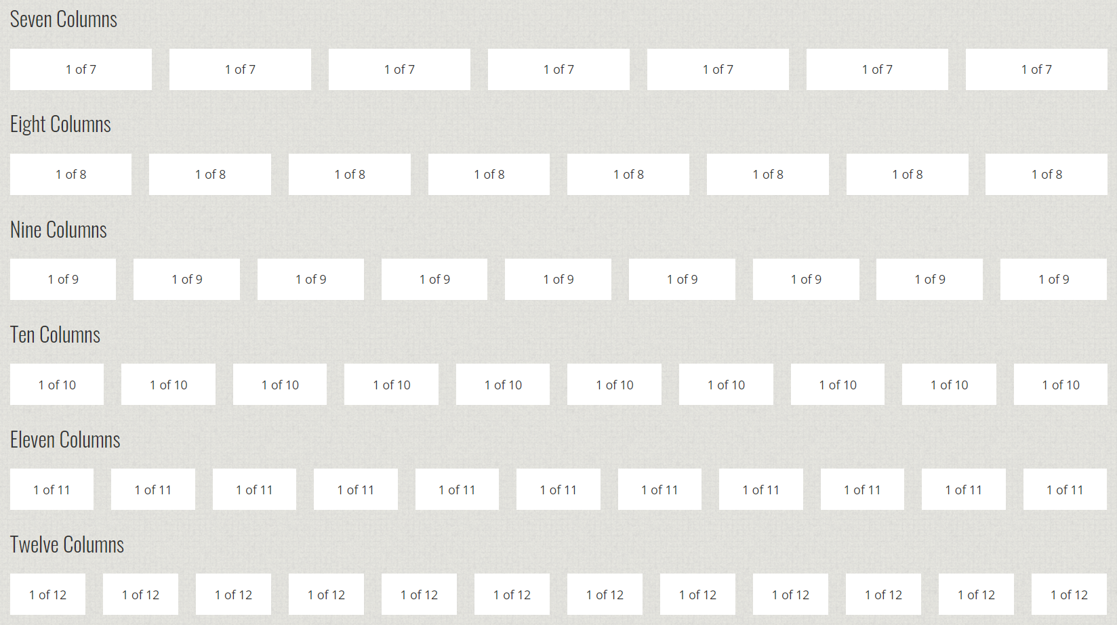

Slide 16
Responsive - screen size
// xs: Extra small devices (portrait phones, less than 576px)
// No media query since this is the default in Bootstrap
// sm: Small devices (landscape phones, 576px and up)
@media (min-width: 576px) { ... }
// md: Medium devices (tablets, 768px and up)
@media (min-width: 768px) { ... }
// lg: Large devices (desktops, 992px and up)
@media (min-width: 992px) { ... }
// xl: Extra large devices (large desktops, 1200px and up)
@media (min-width: 1200px) { ... }

Slide 17
CSS references
CSS selectors: https://www.w3schools.com/cssref/css_selectors.asp
CSS functions: https://www.w3schools.com/cssref/css_functions.asp
CSS units: https://www.w3schools.com/cssref/css_units.asp
Bootstrap framework: https://getbootstrap.com/docs/4.5/getting-started/introduction/
Grid system: https://getbootstrap.com/docs/4.5/layout/grid/
Screen sizes: https://getbootstrap.com/docs/4.5/layout/overview/#responsive-breakpoints

Slide 18
SCSS
Introduce SCSS
Variables
Nesting
Mixins
Functions
Why need to use SCSS? Advantage when using SCSS compare to CSS.

Slide 19
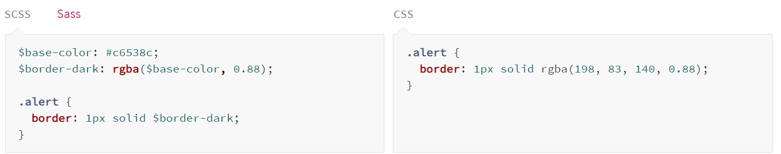
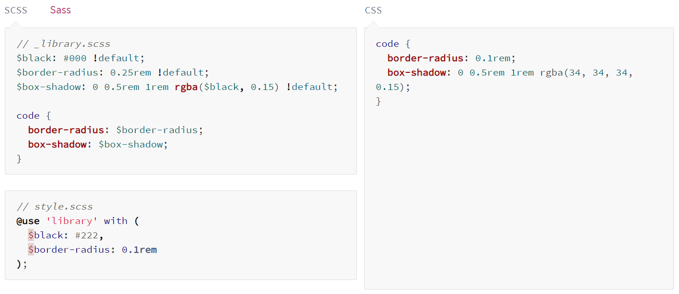
SCSS variable

Slide 20
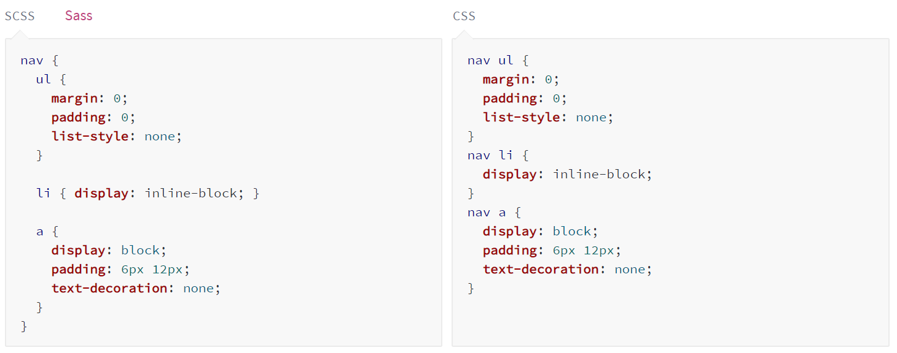
SCSS nesting

Slide 21
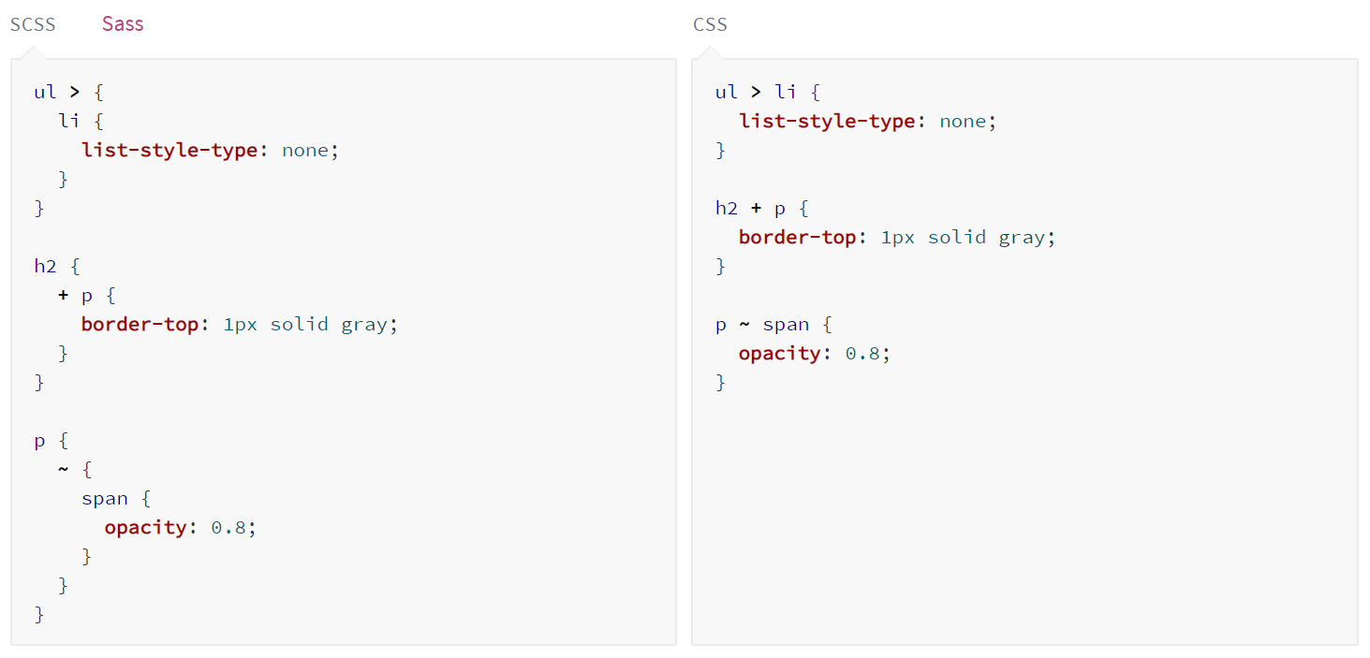
SCSS selector

Slide 22
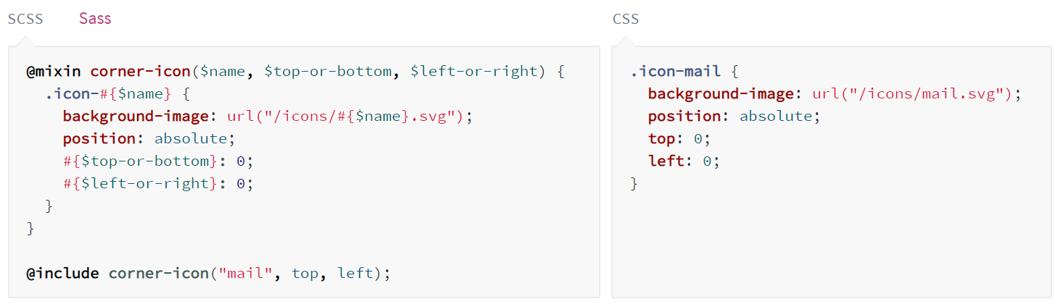
SCSS mixins

Slide 23
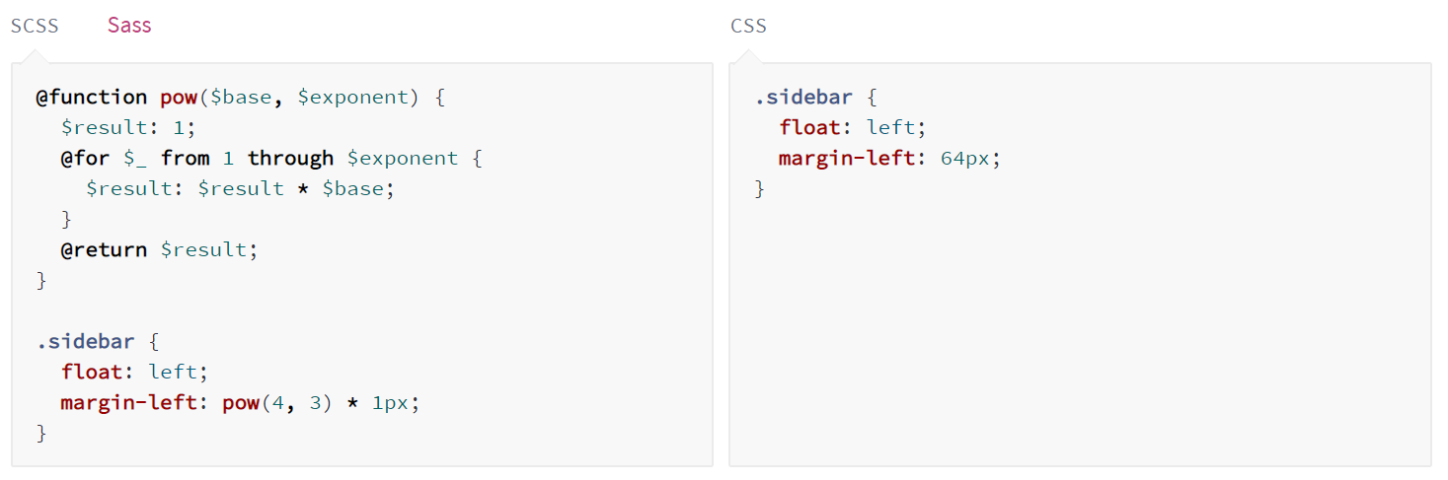
SCSS function

Slide 24
References
Sass document: https://sass-lang.com/documentation

Slide 25
Tools and Others
Visual Studio Code
Visual Studio
Support multiple browsers like Chrome, IE, Edge, Firefox
GUI have to be as same as design
Training project template repository:
https://github.com/preciofishbone-training/training-project-template

Slide 26
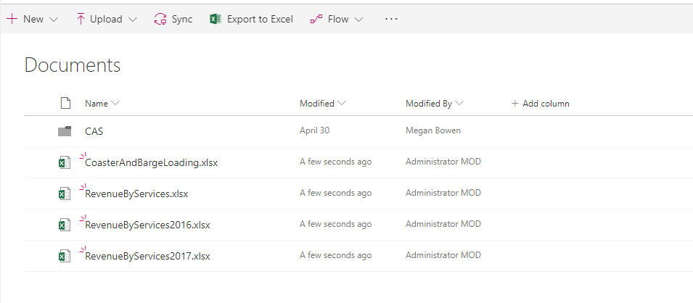
Assignment (Desktop)
Using Bootstrap and SCSS to create a simple html page as the image

Slide 27
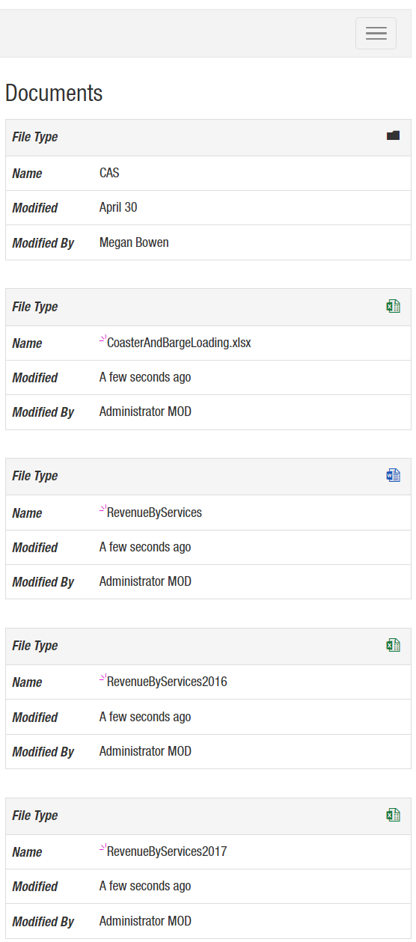
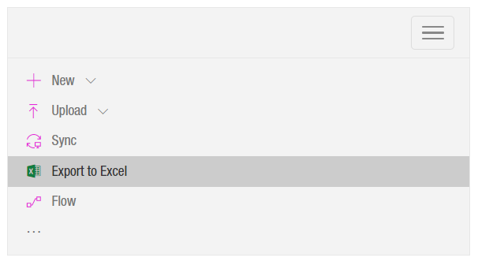
Assignment (Mobile)

Slide 28
Reference resources
https://www.w3schools.com/css/default.asp
https://developer.mozilla.org/en-US/docs/Learn/Getting_started_with_the_web/CSS_basics
https://tutorialzine.com/2016/08/20-protips-for-writing-modern-css
https://css-tricks.com/
https://www.tothenew.com/blog/10-best-practices-in-css/

